Slide 1
Hotel Management system
Submitted By
Md Junaeid Bhuyian 160104055
Afranul Haque 160104059
Nazmus Sakib 160104072
Md. Ruhul Amin 160104074

Slide 2

Project Introduction
Here we described the ERD means Entity Relationship Diagram which represents the data modeling tools.
By using this ERD model we can easily understand the relationship between the entity of our database.
Hotel management system is mainly a desktop based application. This project will be developed to maintain a hotel in a digitalized way.
Our main goal is to digitalize the analog system. Hopefully it will be able to reduce times and troubles of administrators of a hotel.

Slide 3
Name of Entities with primary,foreign and composite Keys
ENTITIES:
R eceptionist(Primary Key :Recep_ID)
Customer(Primary Key : Cus_ID)
Room(Primary Key : Room_no)
Food (Primary Key : Food_ID , Foreign Key :Cus_ID)
Manager(Primary Key:ManagerID)
Employee (Primary Key : Emp_ID)
Booking(Primary Key : Book_ID, Foreign Key :Cus_ID,Room_no )
CheckIn (Primary Key : CheckIN_ID, )

Slide 4
ENTITY RELATIONSHIP DIAGRAM

Slide 5
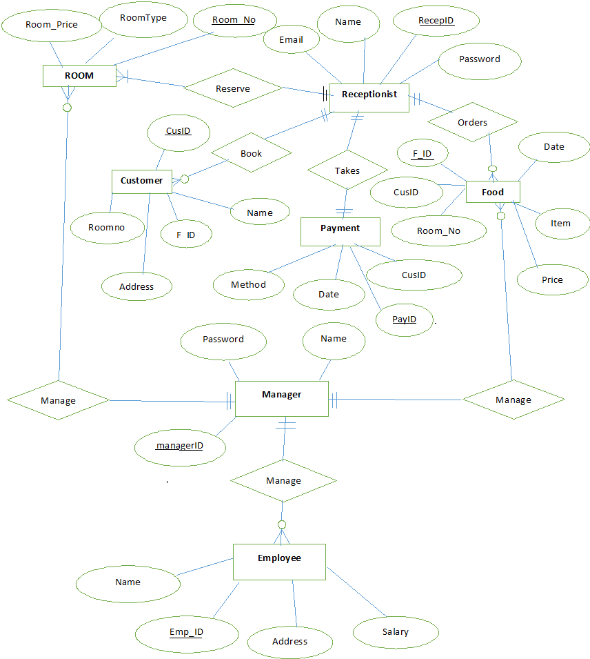

Slide 6
RELATIONAL MODEL

Slide 7
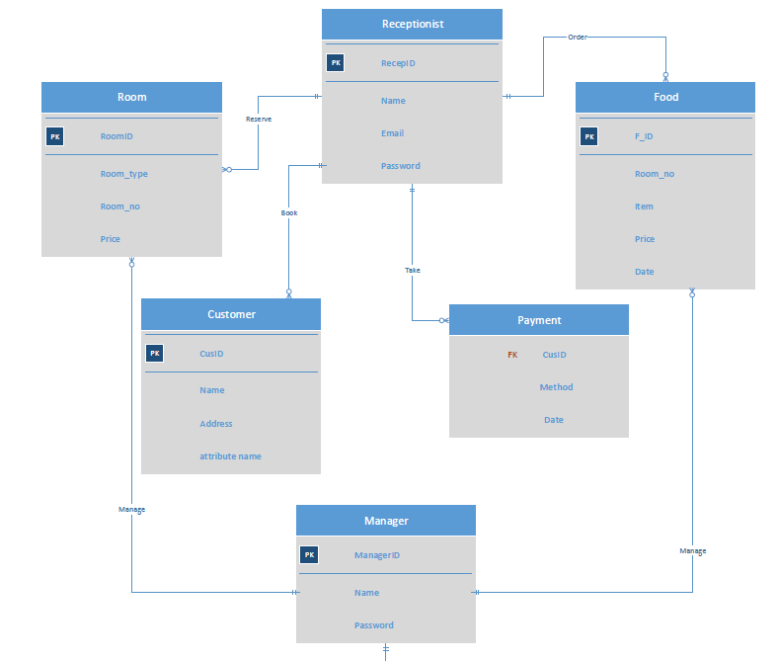

Slide 8
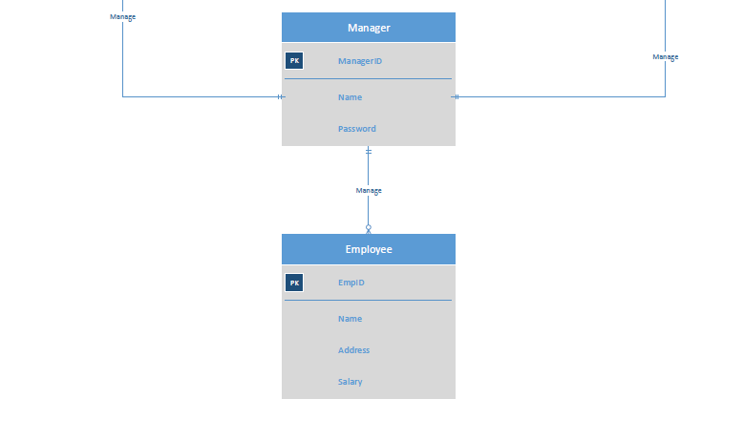
Create table Receptionist{
RecepID INT;
Receptionist_Name Varchar;
Receptionist_Email varchar;
Password varchar ;
PRIMARY KEY(RecepID)
};

Slide 9
Create table Customer{
Cus_ID INT;
Customer_name Varchar;
Customer_address varchar;
…
PRIMARY KEY(Cus_ID)
};
Create table Booking{
Book_ID INT;
Cus_ID INT;
Room_No INT;
Booking_date Varchar;
deposit double;
…
PRIMARY KEY(Book_ID);
FOREIGN KEY (Cus_ID) REFERENCES Customer(Cus_ID);
FOREIGN KEY (Room_no) REFERENCES Room(Room_no);
};

Slide 10
Create table ROOM{
Room_No INT;
Room_type Varchar;
Price Double;
…
PRIMARY KEY(Room_No)
};
Create table CheckIN{
CheckIn_ID INT;
Cus_ID INT;
Room_No INT;
date varchar;
…
PRIMARY KEY(CheckIn_ID);
};

Slide 11
Create table Food{
FooD_ID INT;
Food_item Varchar;
Food_price double;
Cus_Id INT;
…
PRIMARY KEY(Food_ID);
FOREIGN KEY(Cus_ID) REFERENCES Customer(Cus_ID);
};
Create table Payment{
Date Varchar;
Method double;
Cus_ID INT;
…
FOREIGN KEY(Cus_ID) REFERENCES Customer(Cus_ID);
};

Slide 12
Create table Manager{
Manager_ID INT;
Manager_name Varchar;
Password varchar;
…
PRIMARY KEY(Manager_ID)
};
Create table Employee{
Emp_ID INT;
Employee_name Varchar;
salary Double;
Emp_Address varchar;
…
PRIMARY KEY(Emp_ID)
};

Slide 13
Thank You

